Slide 1

Music Store Data Analysis Using SQL

Slide 2


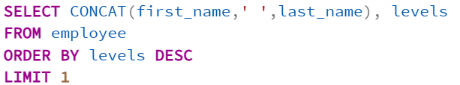
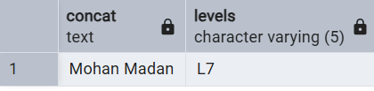
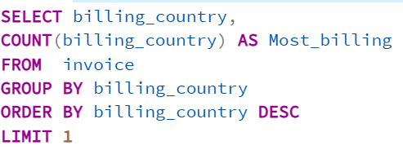
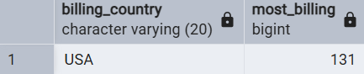

1) Find the most senior employee based on job title.
Easy Queries
SQL Query
Output
2) Determine which countries have the most invoices.
SQL Query
Output

Slide 3
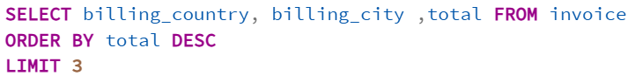
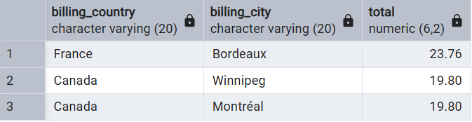
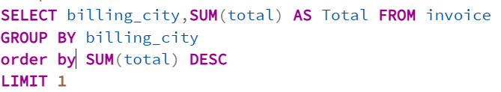
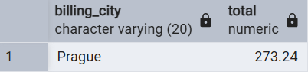
3) What are top 3 values of total invoice?
Output
SQL Query
4) Find the city with the highest total invoice amount to determine the best location for
--a promotional event.
SQL Query
Output

Slide 4
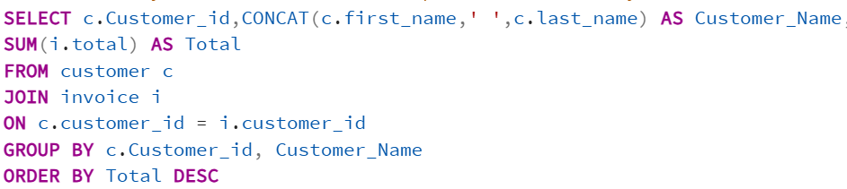
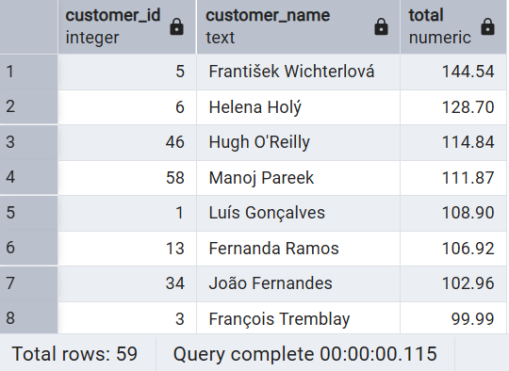
5) Identify the customer who has spent the most money.
SQL Query
Output

Slide 5
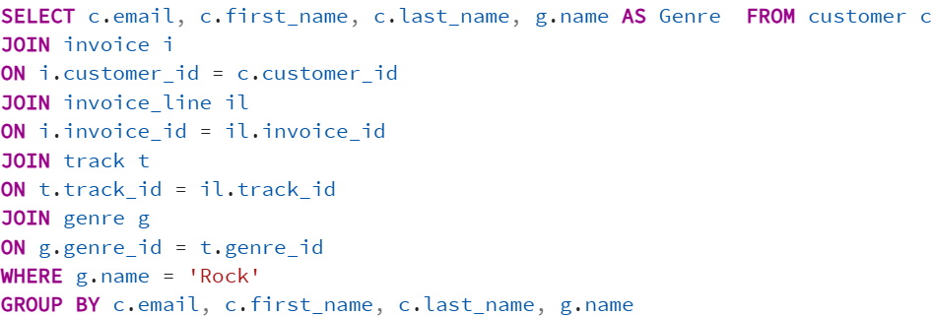
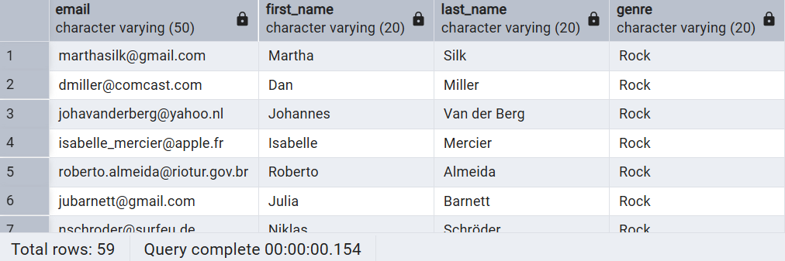
1) Find the email, first name, and last name of customers who listen to Rock music.
Moderate Queries
SQL Query
Output

Slide 6
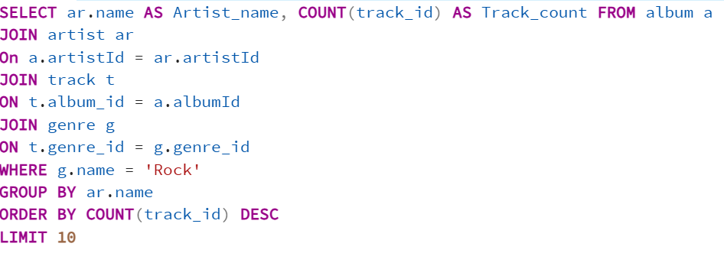
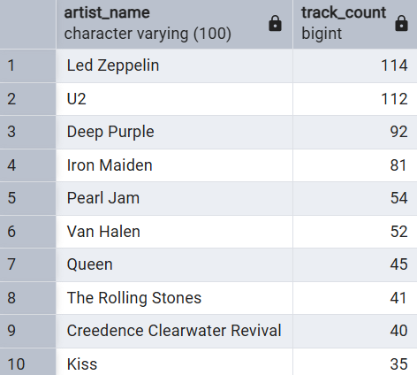
2) Identify the top 10 rock artists based on track count.
Output
SQL Query

Slide 7
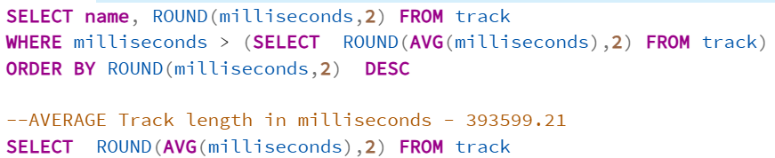
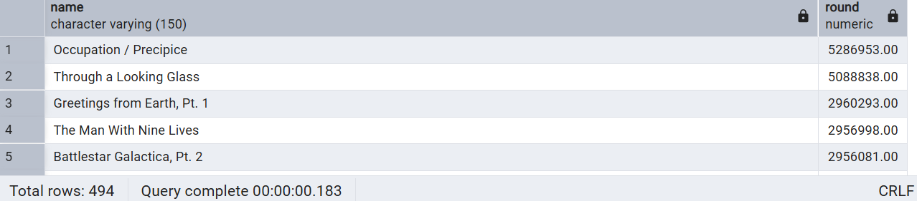
3) Find all track names that are longer than the average track length.
SQL Query
Output

Slide 8
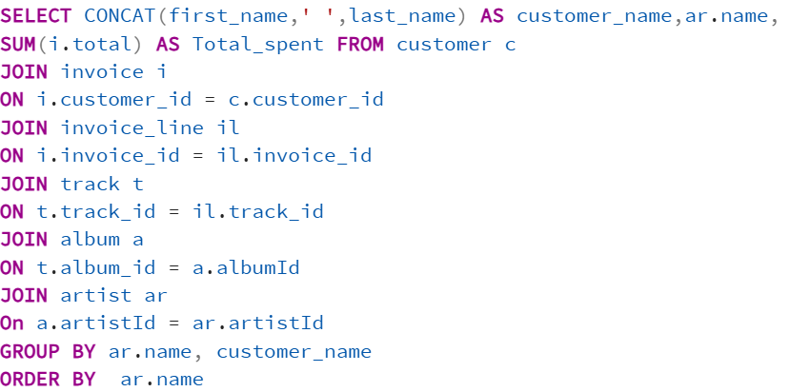
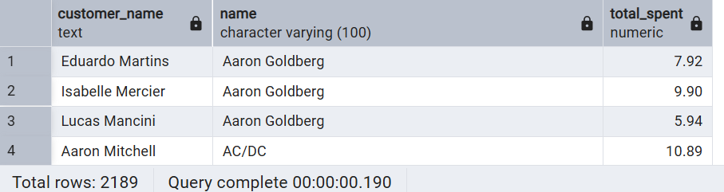
1) Calculate how much each customer has spent on each artist.
Advanced Queries
Output
SQL Query

Slide 9
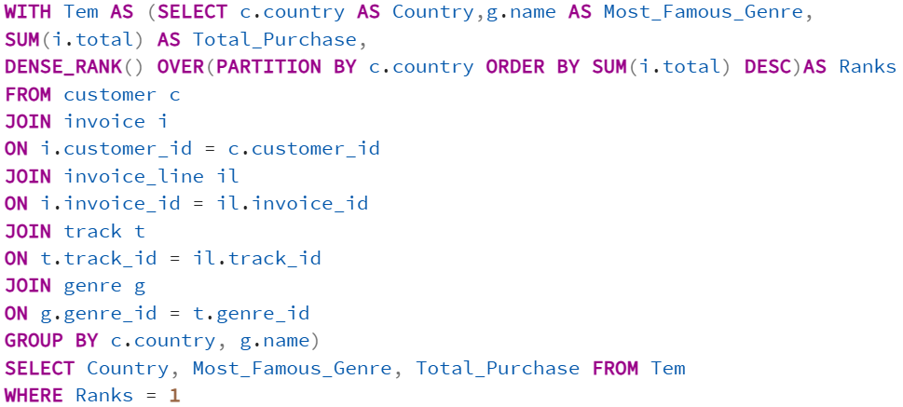
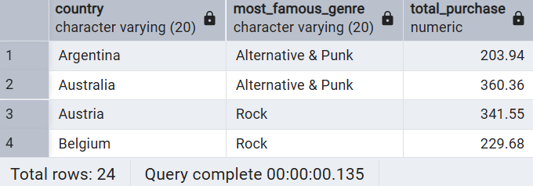
2) Determine the most popular music genre for each country based on purchases.
SQL Query
Output

Slide 10
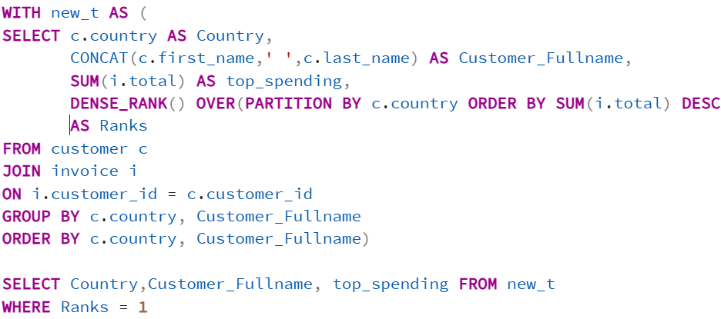
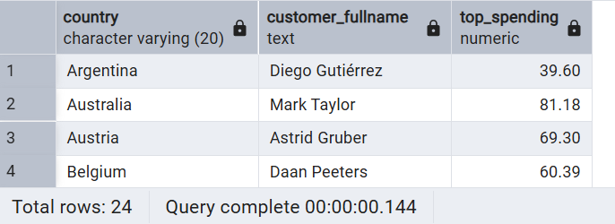
3) Identify the top-spending customer for each country.
SQL Query
Output

Slide 11

Conclusion:
Successfully analyzed a digital music store database using SQL queries.
Identified top-selling tracks, artists, albums, and most popular music genres.
Evaluated customer purchasing behavior and segmented high-value customers.
Analyzed revenue distribution across countries and highlighted regional trends.
Assessed employee performance based on customer interactions and sales.

Slide 12
THANK YOU

